Slide 1


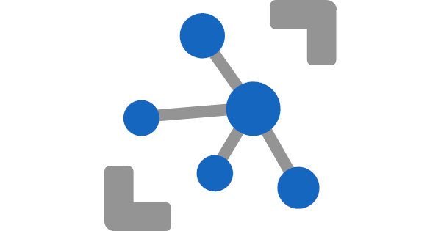


IoT Solution/Smart Start using - Azure IoTHub, - Azure Stream Analytics - and Azure SQL
Meinrad Weiss
SR Cloud Solution Architect
21.06.2021

Slide 2
Agenda
Goal and Solution Overview
Deploy Solution
Internals
Auto Signal Registration
Handle Duplicate Values
Storage Details
Poor man’s digital twin
Restrict Data Access
Efficient Queries
Monitor activity/reset the database
Database Tiers
Conclusion and next Steps

Slide 3
Goal of todays session
The goal of the workshop is to share real live experience from some IoT projects
Understand the purpose of the used Azure Services
Azure Storage Account
Azure IoT Hub
Azure Stream Analytics Job
Azure SQL Database
To enable you to setup POC environments with just a few clicks
We share not only our knowledge but also a GitHub repo with blueprints that are ready to be deployed
It is not an official Microsoft project. No guarantee at all.
To get a POC environment that is (close to) production quality
You have to review the code yourself and give it a good to go
To have fun ☺

Slide 4
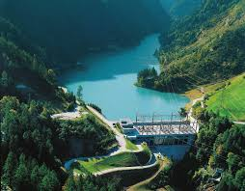




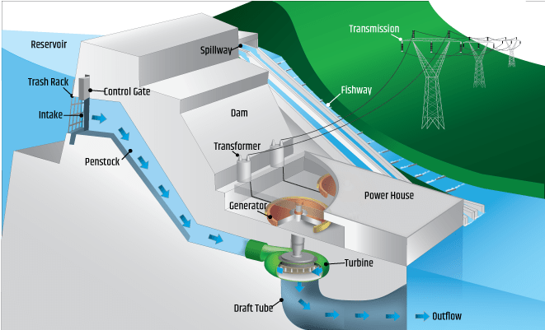


Source of the Architecture (Axpo Hydro)
IoT Edge
IoT Hub
Stream Analytics
Azure SQL Database
Web
Application
Azure
Machine
Learning
/Azure Functions
Third
Party

Slide 5
Main goals/requirements and features
Optimal ingest and query performance
Minimal impact if database grows
Use PaaS services and functionality
Auto registration of new Devices/Signals
Avoid duplicate delivery of events
(Keep them for quality control)
Deal with mal formed events
(Keep them for quality control)
Show data only allowed rows, company internal but also for third party users
IoT Hub
Stream Analytics
Azure SQL Database
Keep history of all security relevant meta data changes
Replace signal name with internal SignalId
(Tuned for efficiency)
Reference
Data

Slide 6
Source of the Architecture (Axpo Hydro)
IoT Edge
IoT Hub
Stream Analytics
Azure SQL Database
Web
Application
Reference
Data
Azure
Machine
Learning
/Azure Functions
Third
Party

Slide 7

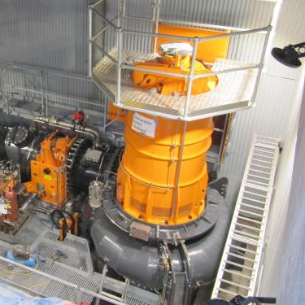
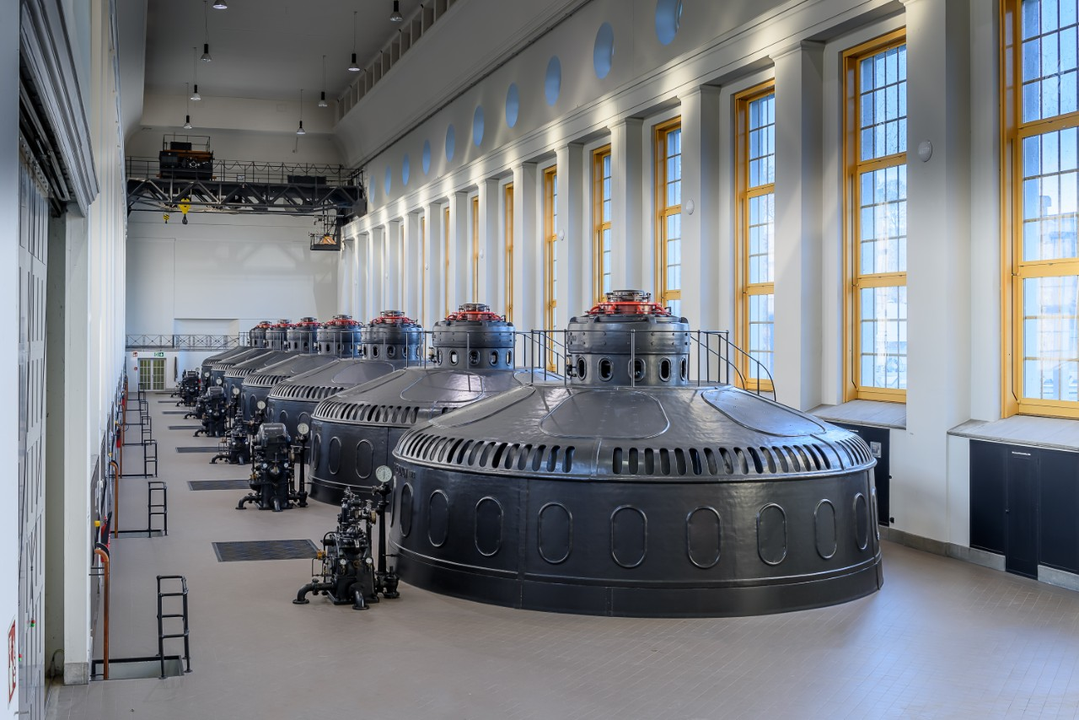
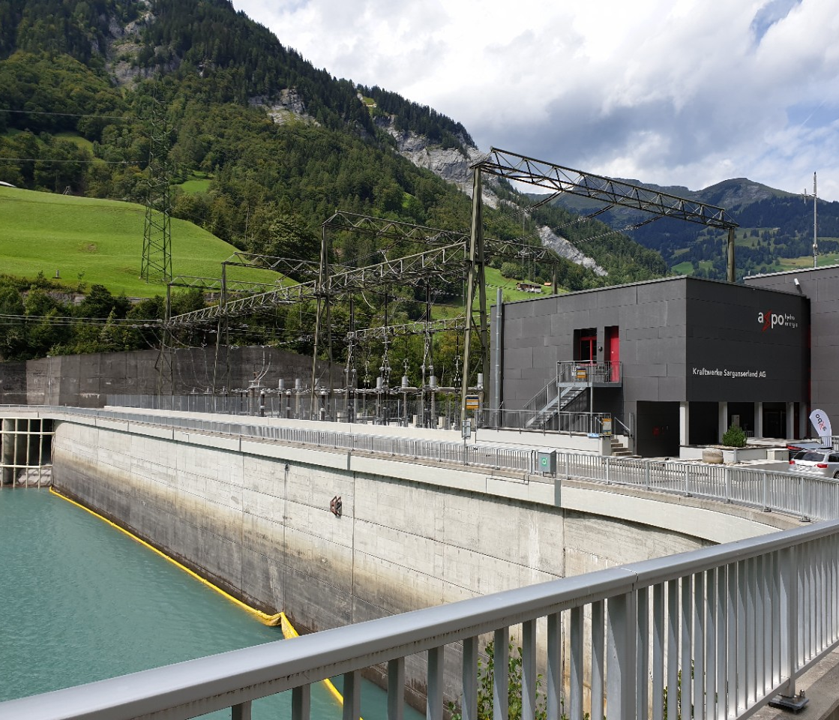
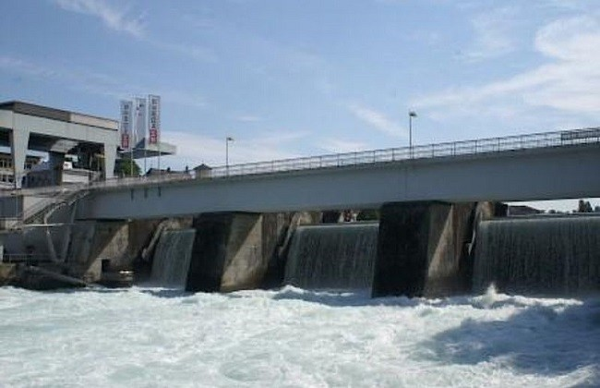
Facts & Figures
6 Power Plants
10 Locations
~ 70’000 Measurement Points
~ 40’000’000 Events per Day

Slide 8
Facts & Figures
6 Power Plants
10 Locations
~ 70’000 Measurement Points
~ 40’000’000 Events per Day

Slide 9
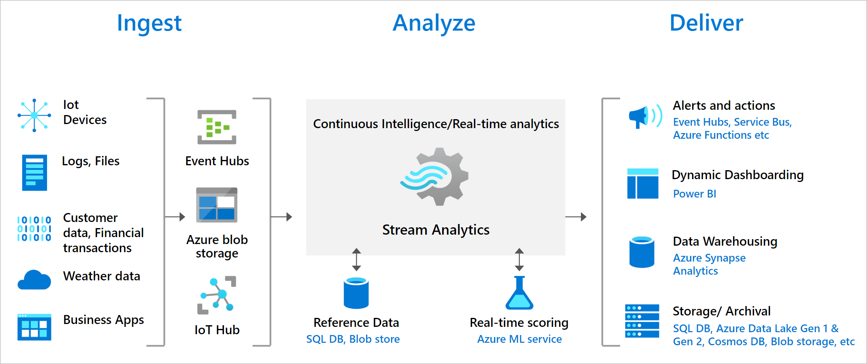
Azure Stream Analytics
Azure Stream Analytics is a real-time analytics and complex event-processing engine that is designed to analyze and process high volumes of fast streaming data from multiple sources simultaneously. Azure Stream Analytics | Microsoft Azure

Slide 10
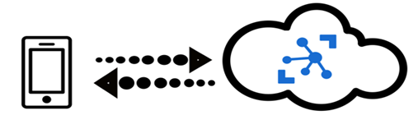
Azure IoT Hub (Edge)
IoT Hub is a managed service hosted in the cloud that acts as a central message hub for communication between an IoT application and its attached devices. You can connect millions of devices and their backend solutions reliably and securely. Almost any device can be connected to an IoT Hub.
Several messaging patterns are supported, including device-to-cloud telemetry, uploading files from devices, and request-reply methods to control your devices from the cloud. IoT Hub also supports monitoring to help you track device creation, device connections, and device failures.
Azure IoT Edge moves cloud analytics and custom business logic to devices so that your organization can focus on business insights instead of data management.

Slide 11
Data ingest and presentation
Avoid duplicate delivery of events
(Keep them for quality control)
Deal with mal formed events
(Keep them for quality control)
Show data only allowed rows, company internal but also for third party users
IoT Hub
Stream Analytics
Azure SQL Database
Keep history of all security relevant meta data changes
Replace signal name with internal SignalId
(Tuned for efficiency)
Reference
Data

Slide 12
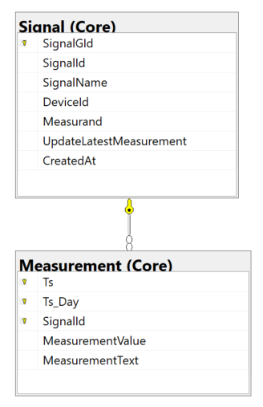
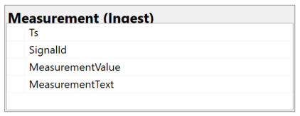
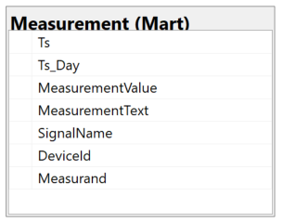
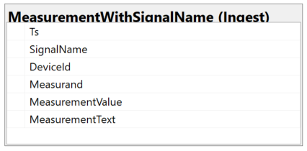
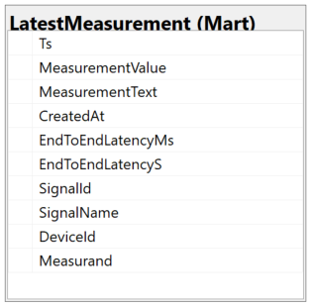
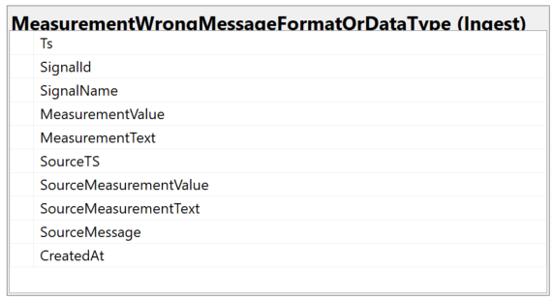
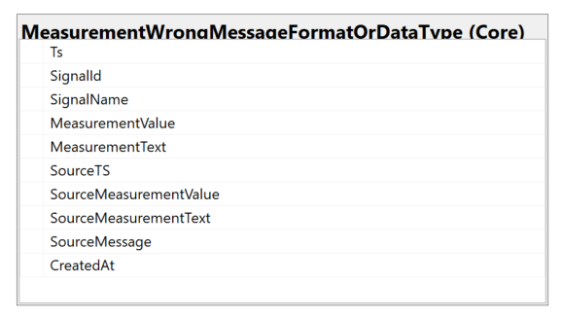
Main Azure SQL Database Structures
Ingest
Core
Mart
Stream Analytics

Slide 13
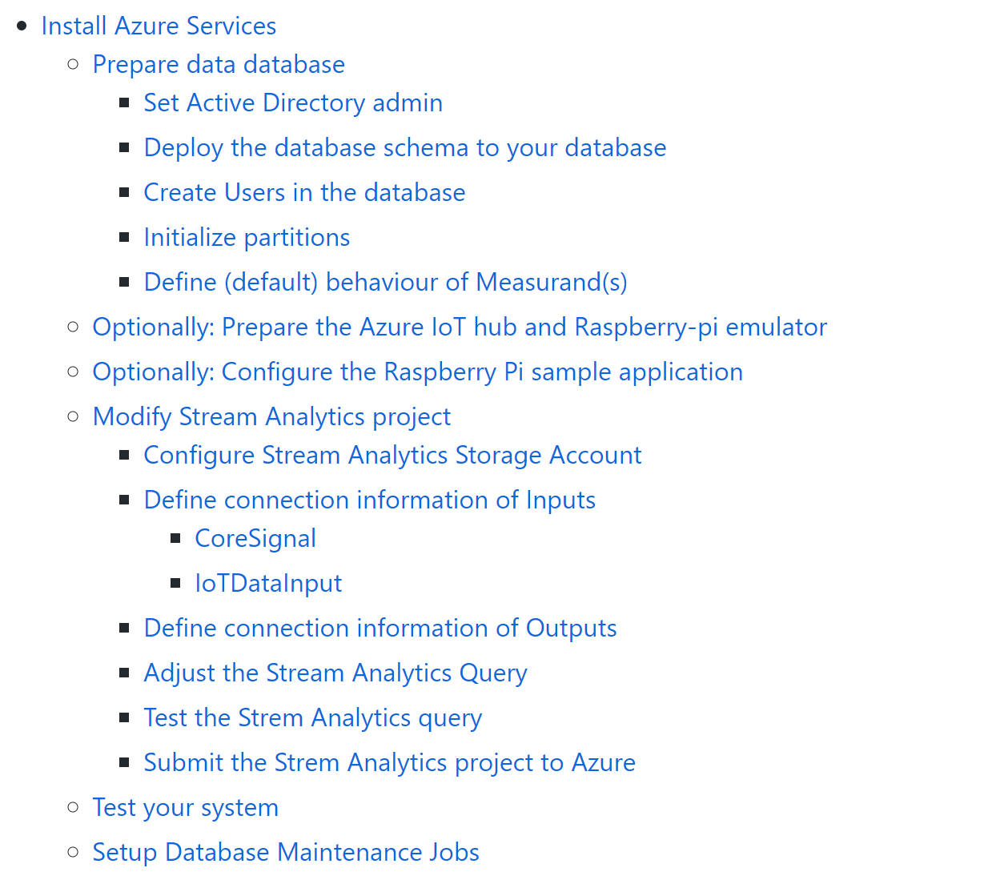
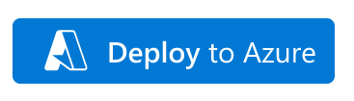
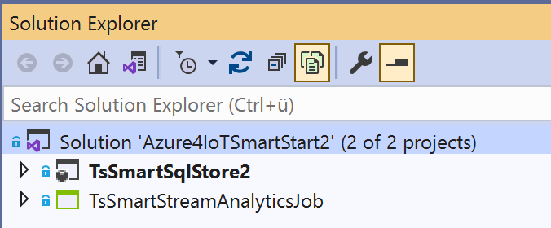
Deployment
https://github.com/meinradweiss/Azure4IoTSmartStart2Public

Slide 14
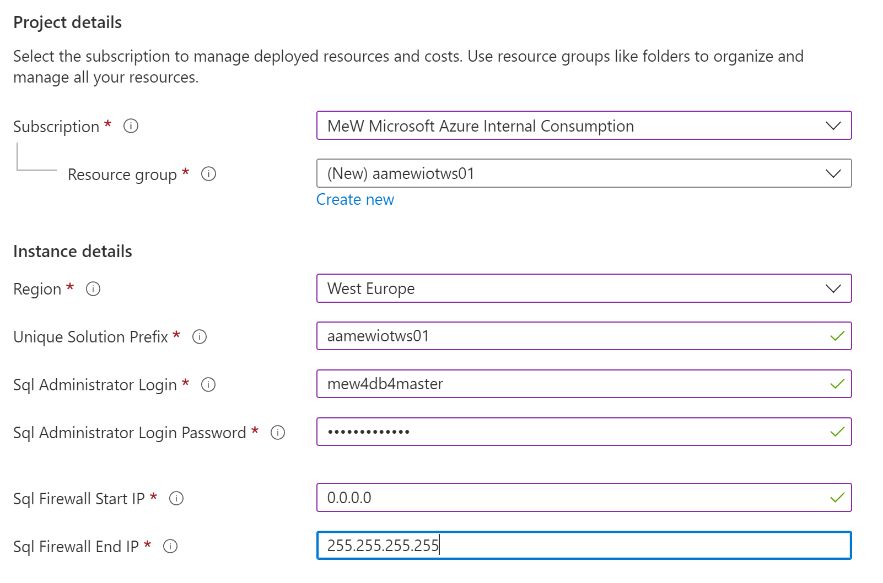
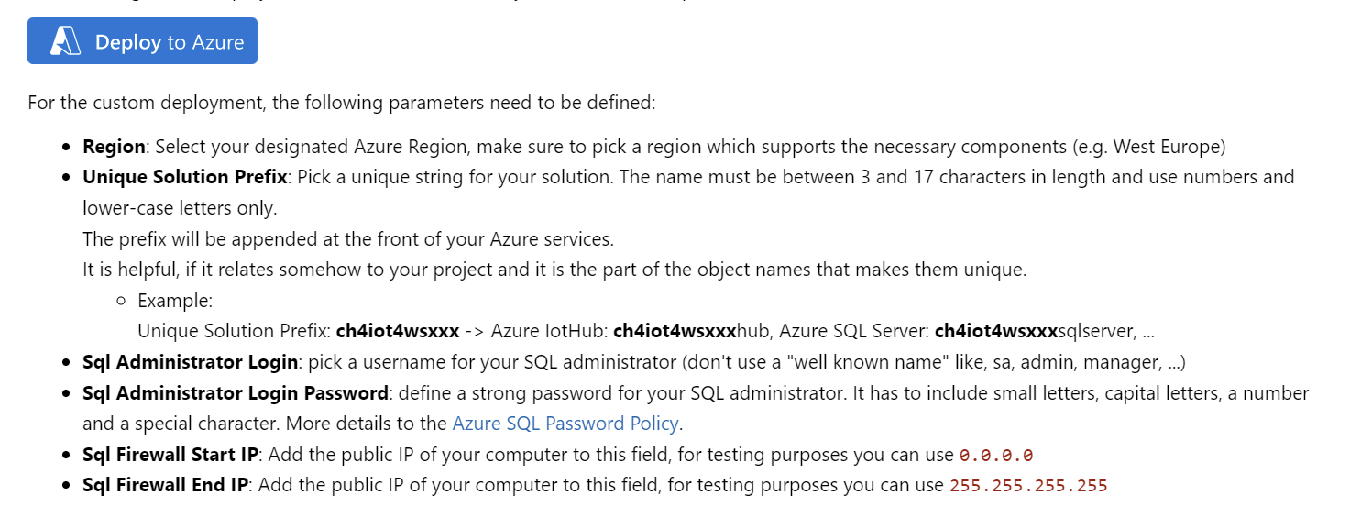
Deploy Azure Services
Notes:
az group deployment create --name <ExampleDeployment> --resource-group <YourResourceGroup> --template-file azuredeployBasic.json

Slide 15
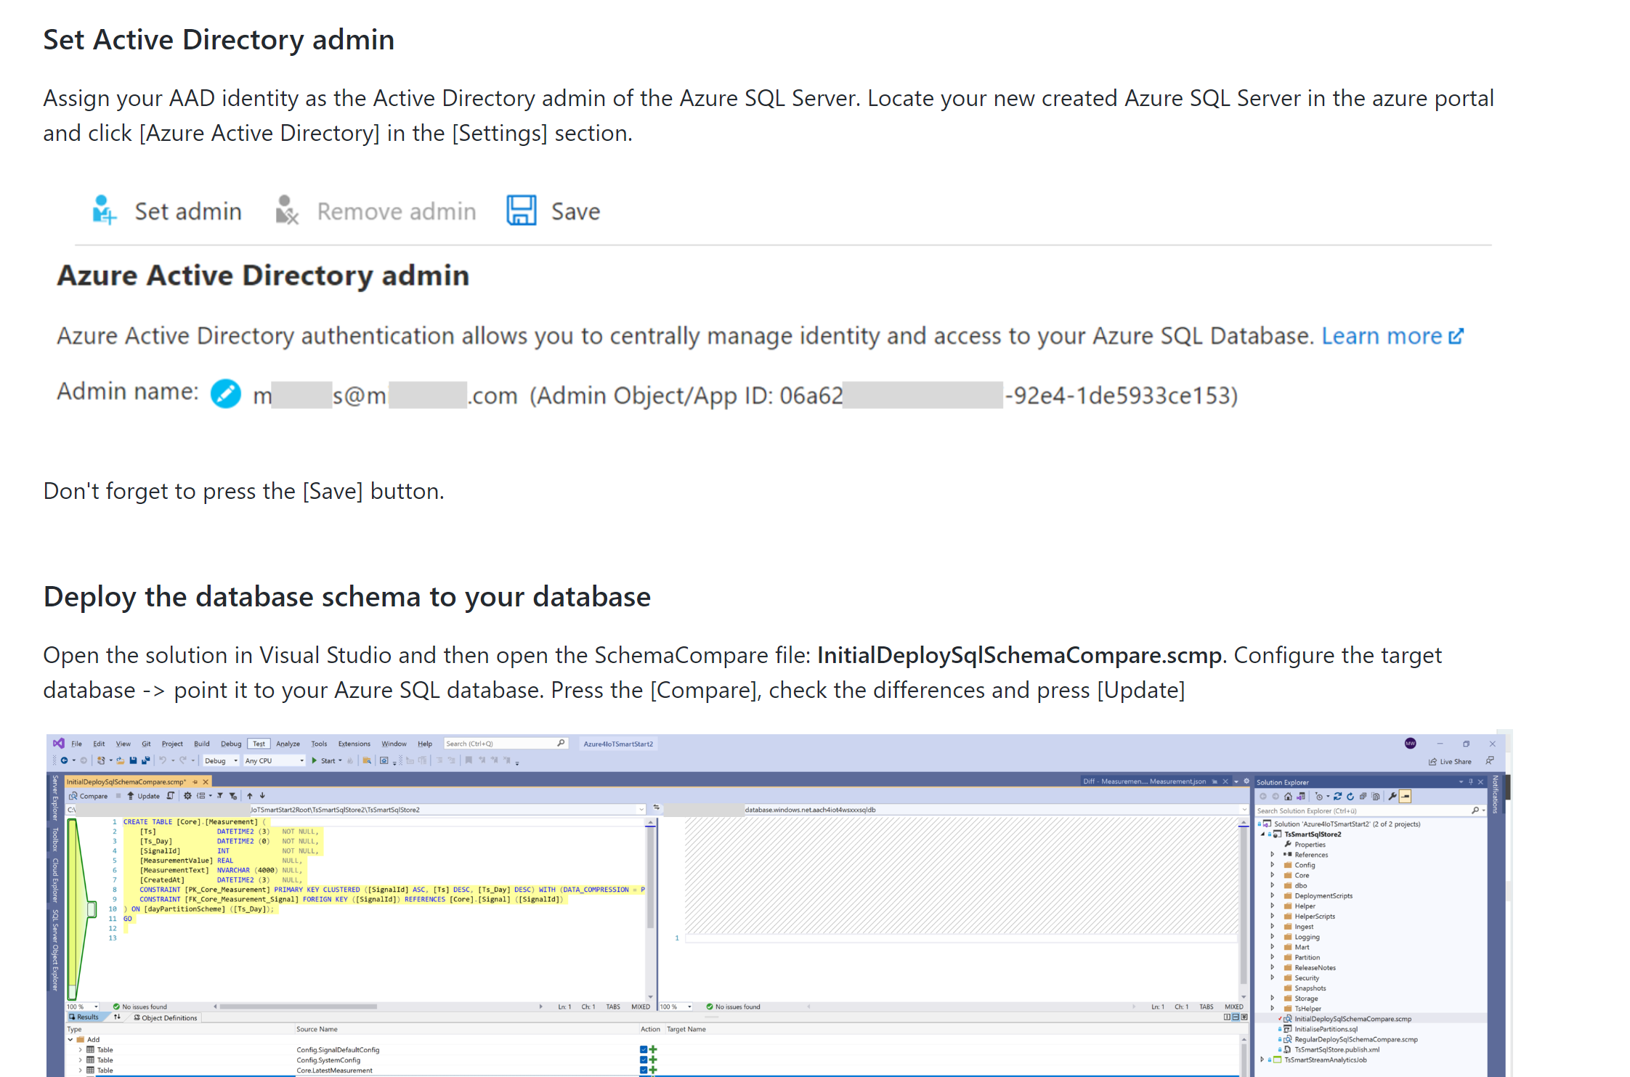
Deploy SQL Database Schema
1

Slide 16
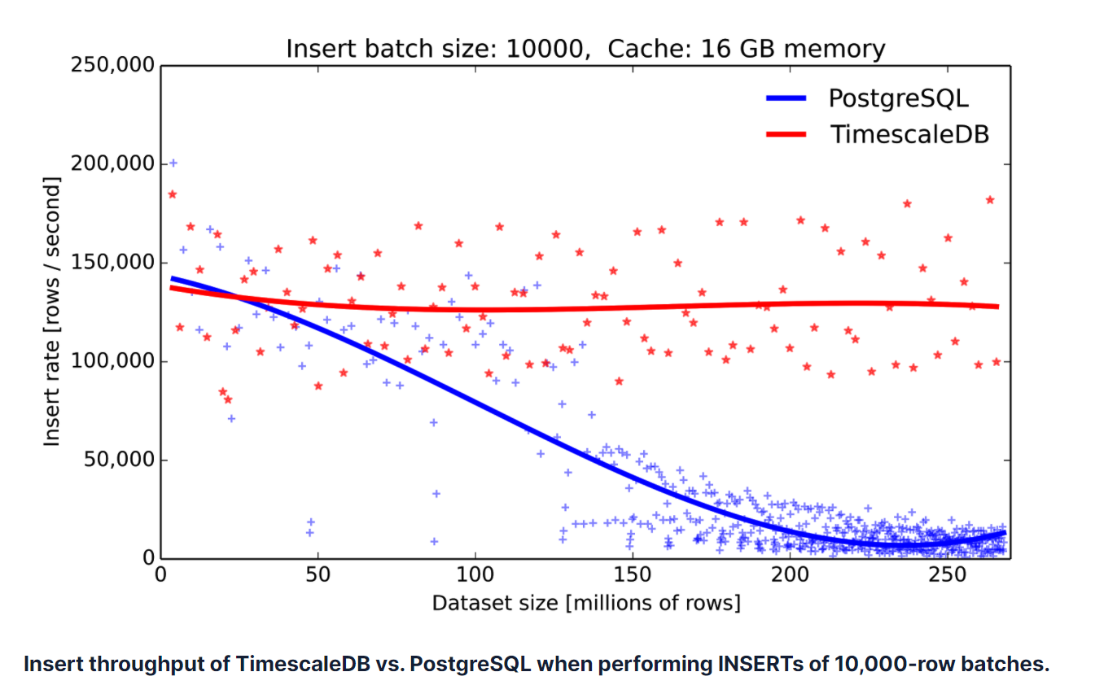


Adjust DB to your project
Source:
Time-series data: Why to use a relational database instead of NoSQL (timescale.com)
1
Goal
Partitions are key to keep performance at an optimal level, even if database is growing
One of the key features of TimescaleDB
Partition borders must cover the time range of the IoT data stored in the database
To maintain the partition border in the future a daily job must be setup (e.g., Data Factory, Synapse Pipelines, Logic App, Data Job, Airflow, Elastic DB Jobs (preview) …)
DECLARE @startDate date
DECLARE @dayAheadNumber int
SET @startDate = GETDATE() -- If we get data starting "today"
SET @dayAheadNumber = 35 -- Default
EXECUTE [Partition].[MaintainPartitionBorders] @startDate, @dayAheadNumber
Schedule once a day
EXECUTE [Partition].[MaintainPartitionBorders]

Slide 17
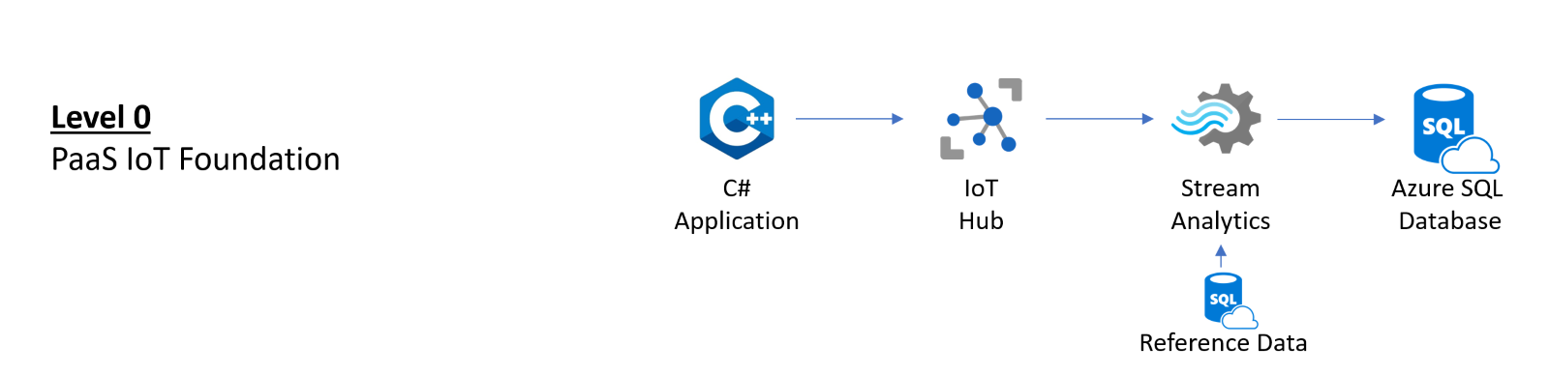
Adjust DB to your project - 2
x
1
x
Add “Stream Analytics” users to the database
Using a ‘managed identity’
Using SQL Server Logins
x
-- In your IoT database
CREATE USER [<ASA_JOB_NAME>] FROM EXTERNAL PROVIDER;
GRANT SELECT, INSERT ON SCHEMA::INGEST TO [<ASA_JOB_NAME>];
GRANT SELECT ON OBJECT::[Core].[Signal] TO [<ASA_JOB_NAME>];
-- In your IoT database
CREATE USER [ASA_MetaDataReader] WITH PASSWORD = '<your strong password 8fdKJl3$nlNv3049jsKK>';
CREATE USER [ASA_TelemetryWriter] WITH PASSWORD = '<your strong password2 9fdKJ85$nlNv3049jsKK#';
GRANT SELECT ON OBJECT::[Core].[Signal] TO [ASA_MetaDataReader]; GRANT SELECT, INSERT ON SCHEMA::INGEST TO [ASA_TelemetryWriter];

Slide 18
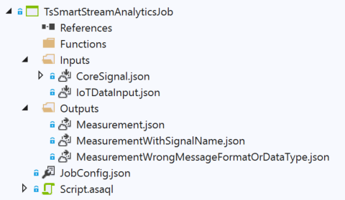
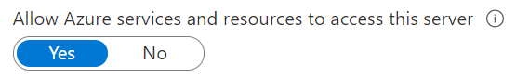
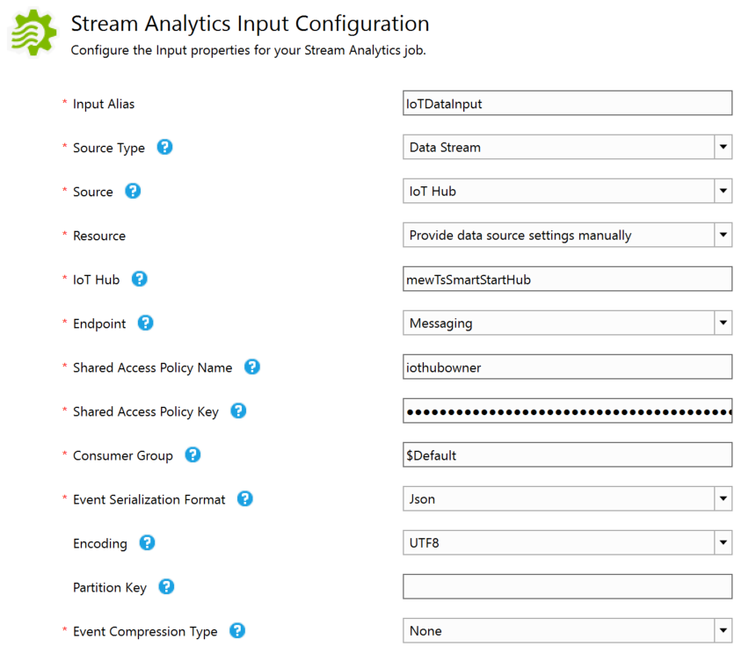
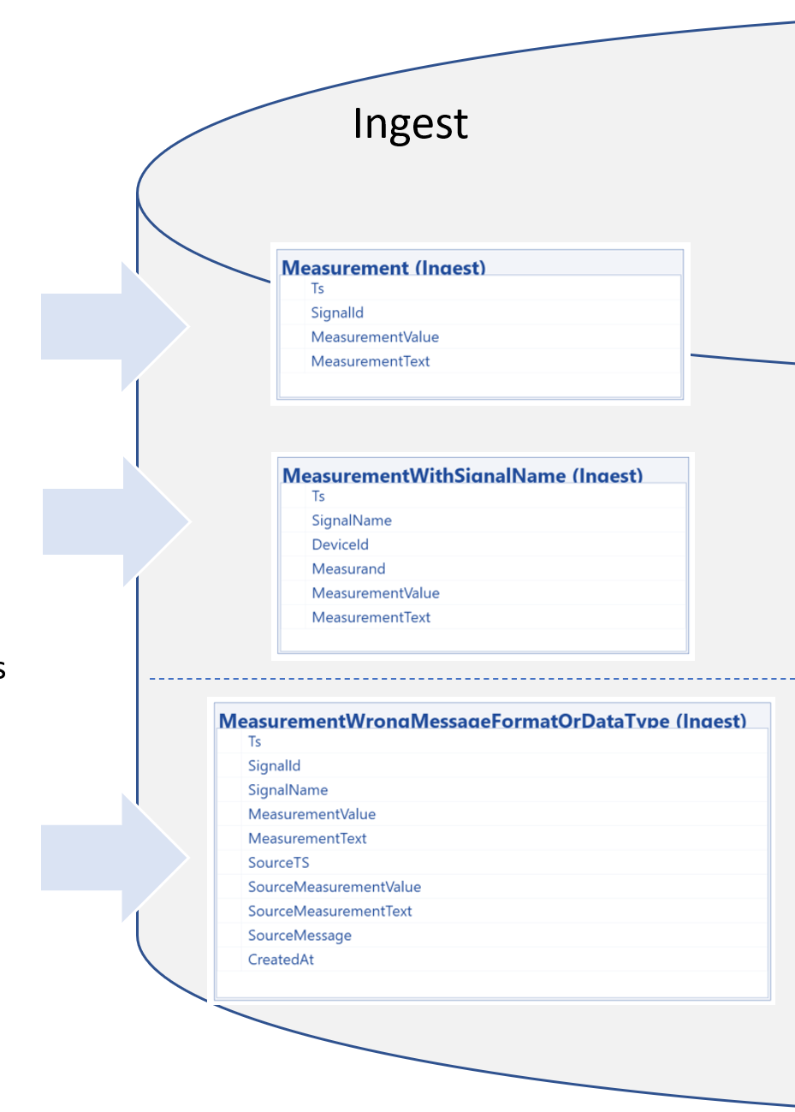
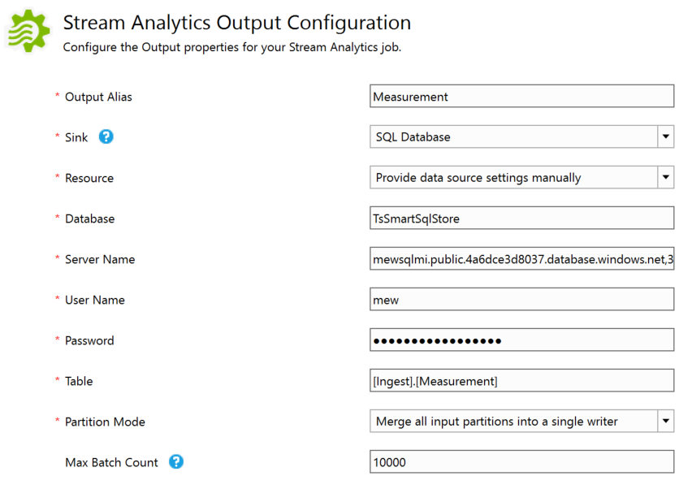
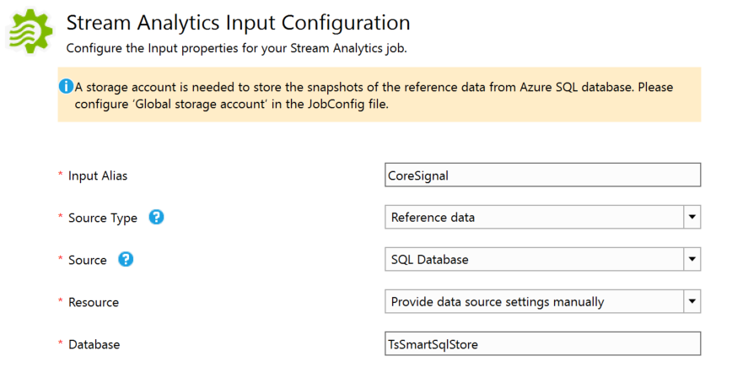
Define and Deploy Stream Analytics Job
Grant access to Azure Services
SELECT [SignalId], [SignalName]
FROM [Core].[Signal]

Slide 19
Define and Deploy Stream Analytics Job - 2
WITH IoTDataInputWithSignalName AS (SELECT
TRY_CAST(EventTimestamp AS DATETIME) AS [Ts]
,IoTHub.ConnectionDeviceId AS [DeviceId]
,SignalLabel AS [Measurand]
,CONCAT(IoTHub.ConnectionDeviceId, '_', SignalLabel) AS [SignalName]
,TRY_CAST([Value] AS FLOAT) AS [MeasurementValue]
,CASE WHEN LEN([Text]) > 0 THEN [Text]
ELSE NULL
END AS [MeasurementText]
,EventTimestamp AS [SourceTS]
,[Value] AS [SourceMeasurementValue]
,[Text] AS [SourceMeasurementText]
,[IoTDataInput] AS [SourceMessage]
FROM [IoTDataInput])
,IoTDataInputWithSignalId AS (SELECT [IoTInput].[Ts]
,[IoTInput].[DeviceId]
,[IoTInput].[Measurand]
,[CoreSignal].[SignalId]
,[IoTInput].[SignalName]
,[IoTInput].[MeasurementValue]
,[IoTInput].[MeasurementText]
,[IoTInput].[SourceTS]
,[IoTInput].[SourceMeasurementValue]
,[IoTInput].[SourceMeasurementText]
,[IoTInput].[SourceMessage]
FROM [IoTDataInputWithSignalName] AS [IoTInput]
LEFT OUTER JOIN [CoreSignal]
ON [IoTInput].[SignalName] = [CoreSignal].[SignalName] )
Message from IoT Hub
{
"EventTimestamp": "2021-12-08T14:01:14.5094082Z",
"SignalLabel": "Temperature",
"Value": "12.34",
"Text": "",
"EventProcessedUtcTime": "2021-12-08T14:01:14.5771421Z",
"PartitionId": 1,
"EventEnqueuedUtcTime": "2021-12-08T14:01:15.0040000Z",
"IoTHub": {
"MessageId": null,
"CorrelationId": null,
"ConnectionDeviceId": "mewTsSmartStartHubDevice001",
"ConnectionDeviceGenerationId": "637740536776612383",
"EnqueuedTime": "2021-12-08T14:01:15.0050000Z"
}
}
Device Message
{
"EventTimestamp": "2021-12-08T13:45:37.5349406Z",
"SignalLabel": "Humidity",
"Value": "67.26993883367159",
"Text": ""
}
Code depends on incoming message structure
“Generic” Code, try to resolve SignalName and provide SignalId

Slide 20
Define and Deploy Stream Analytics Job - 3
3
[MeasurementWrongMessageFormatOrDataType]
SELECT [Ts]
,[SignalId]
,[SignalName]
,[MeasurementValue]
,[MeasurementText]
,[SourceTS]
,[SourceMeasurementValue]
,[SourceMeasurementText]
,[SourceMessage]
INTO [MeasurementWrongMessageFormatOrDataType]
FROM [IoTDataInputWithSignalId]
WHERE [Ts] IS NULL
OR [SignalName] IS NULL
OR (([MeasurementValue] IS NULL)
AND ([MeasurementText] IS NULL)
)
“Generic Code”:
No timestamp or no SignalName or no “Payload”

Slide 21
Define and Deploy Stream Analytics Job - 4
3
[MeasurementWithSignalName]
SELECT [Ts]
,[SignalName]
,[DeviceId]
,[Measurand]
,[MeasurementValue]
,[MeasurementText]
INTO [MeasurementWithSignalName]
FROM [IoTDataInputWithSignalId]
WHERE [Ts] IS NOT NULL
AND ([MeasurementValue] IS NOT NULL
OR [MeasurementText] IS NOT NULL
)
AND [SignalName] IS NOT NULL
AND [SignalId] IS NULL
“Generic Code”:
Timestamp, SignalName and “Payload” is available, but no SignalId

Slide 22
Define and Deploy Stream Analytics Job - 5
3
[Measurement]
SELECT [IoTInput].[Ts]
,[CoreSignal].[SignalId] ,[IoTInput].[MeasurementValue]
,[IoTInput].[MeasurementText]
INTO [Measurement]
FROM [IoTDataInputWithSignalName] AS [IoTInput]
INNER JOIN [CoreSignal]
ON [IoTInput].[SignalName] = [CoreSignal].[SignalName]
WHERE [IoTInput].[Ts] IS NOT NULL
AND ([IoTInput].[MeasurementValue] IS NOT NULL
OR [IoTInput].[MeasurementText] IS NOT NULL )
“Generic Code”:
Timestamp, SignalId and “Payload” is available

Slide 23
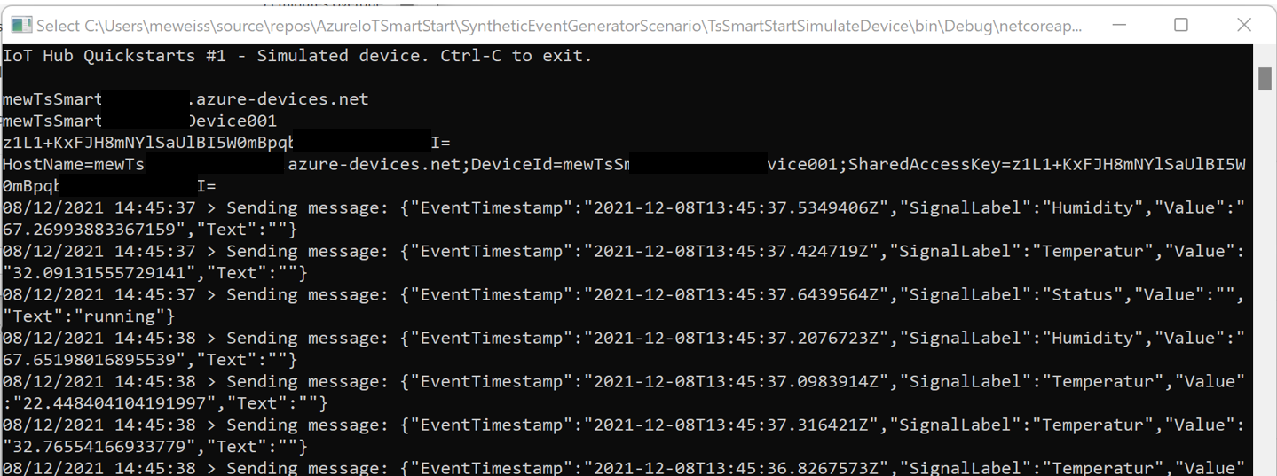
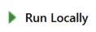
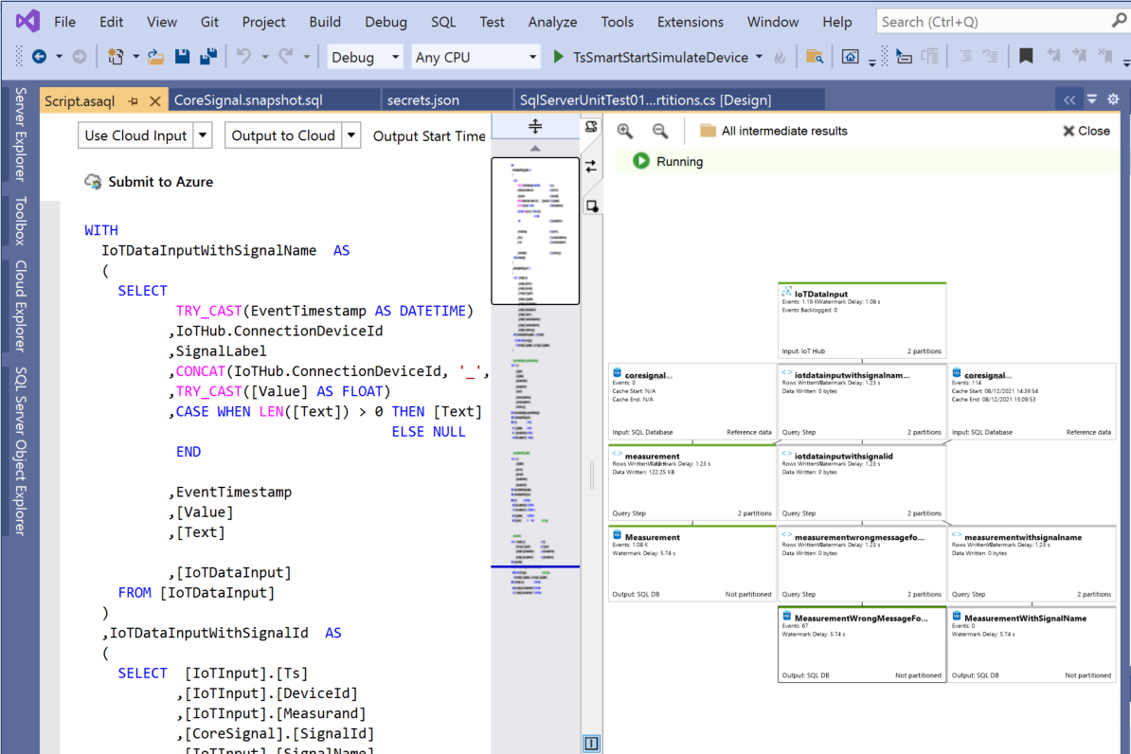
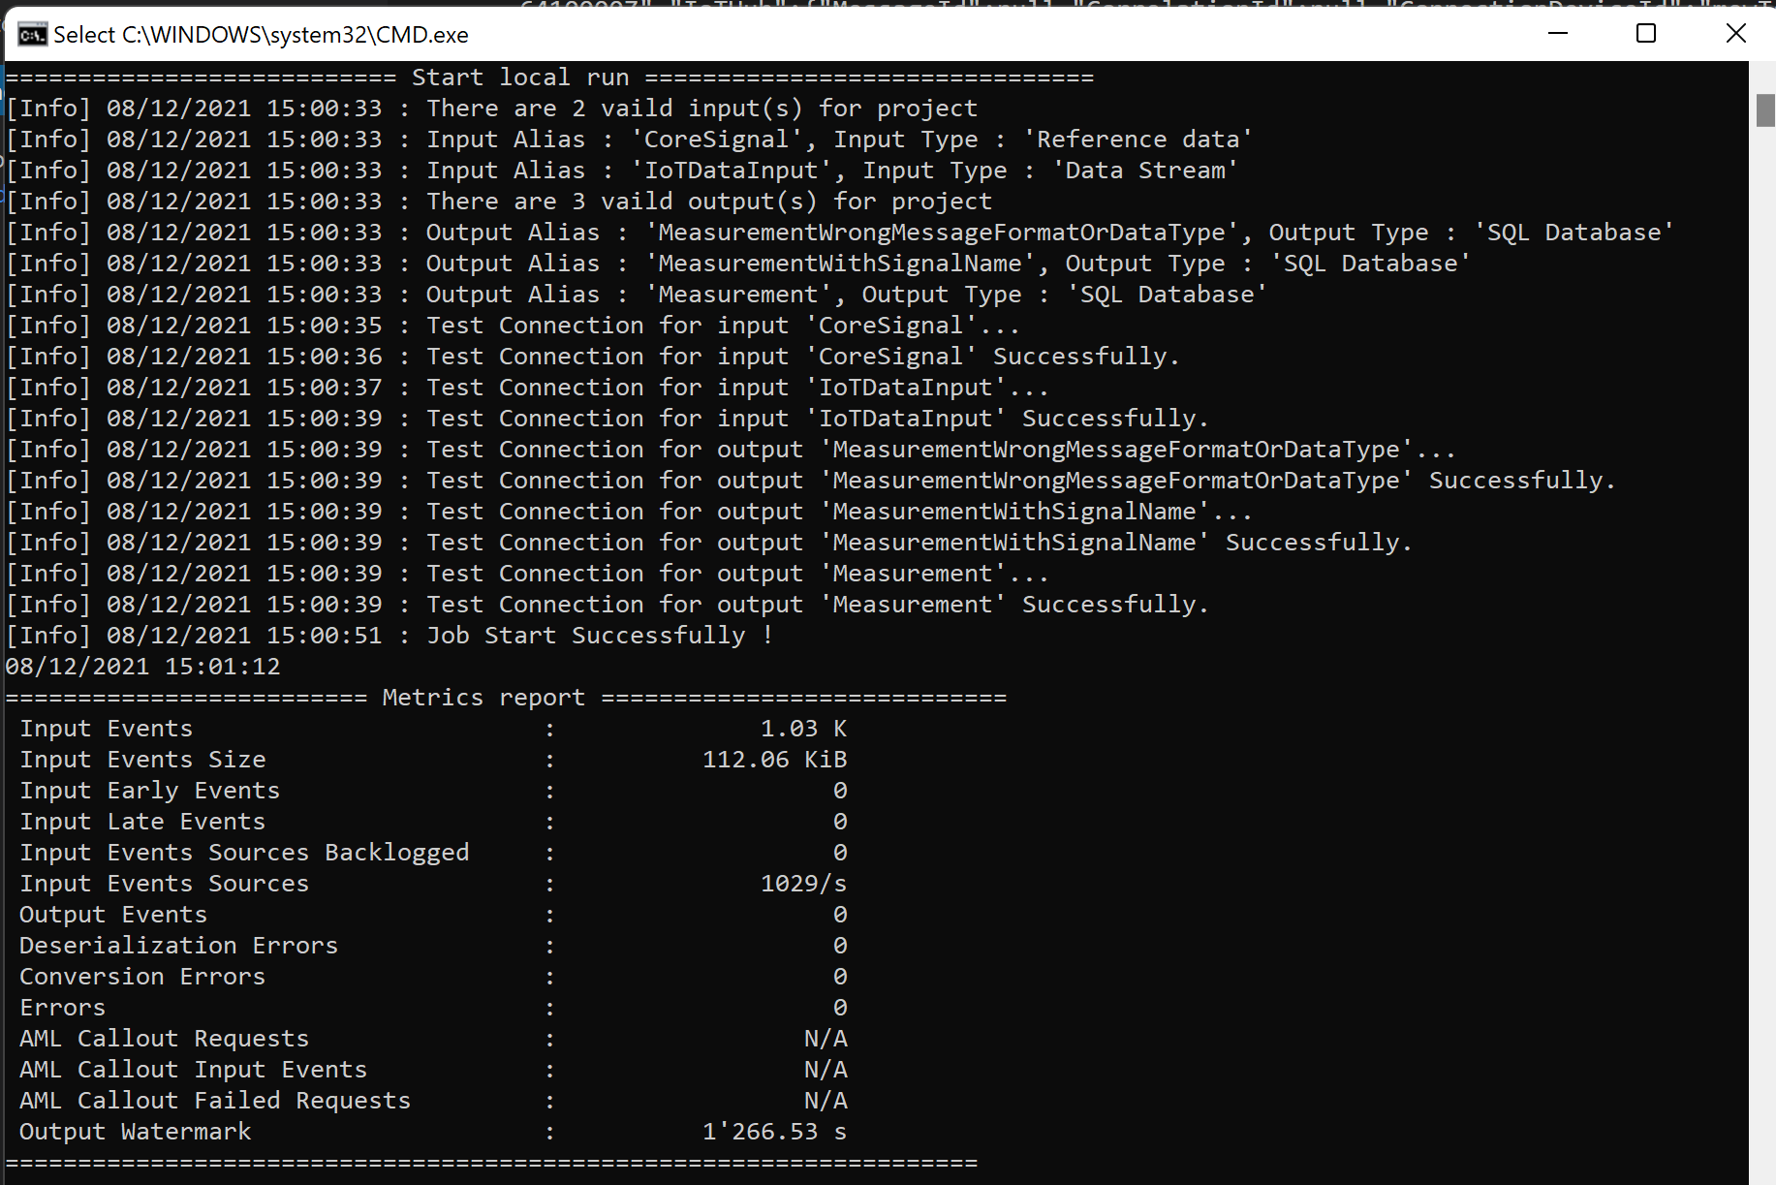
Test Setup in Visual Studio
TsSmartStartSimulateDevice
Build TsSmartStartSimulateDevice in Visual Studio
Open command prompt and move to your debug bin directory (.....\TsSmartStartSimulateDevice\bin\Debug\netcoreapp3.1)
Type: start TsSmartStartSimulateDevice.exe
TsSmartStreamAnalyticsJob
Define Use Cloud Input/Use Cloud Output and Click

Slide 24
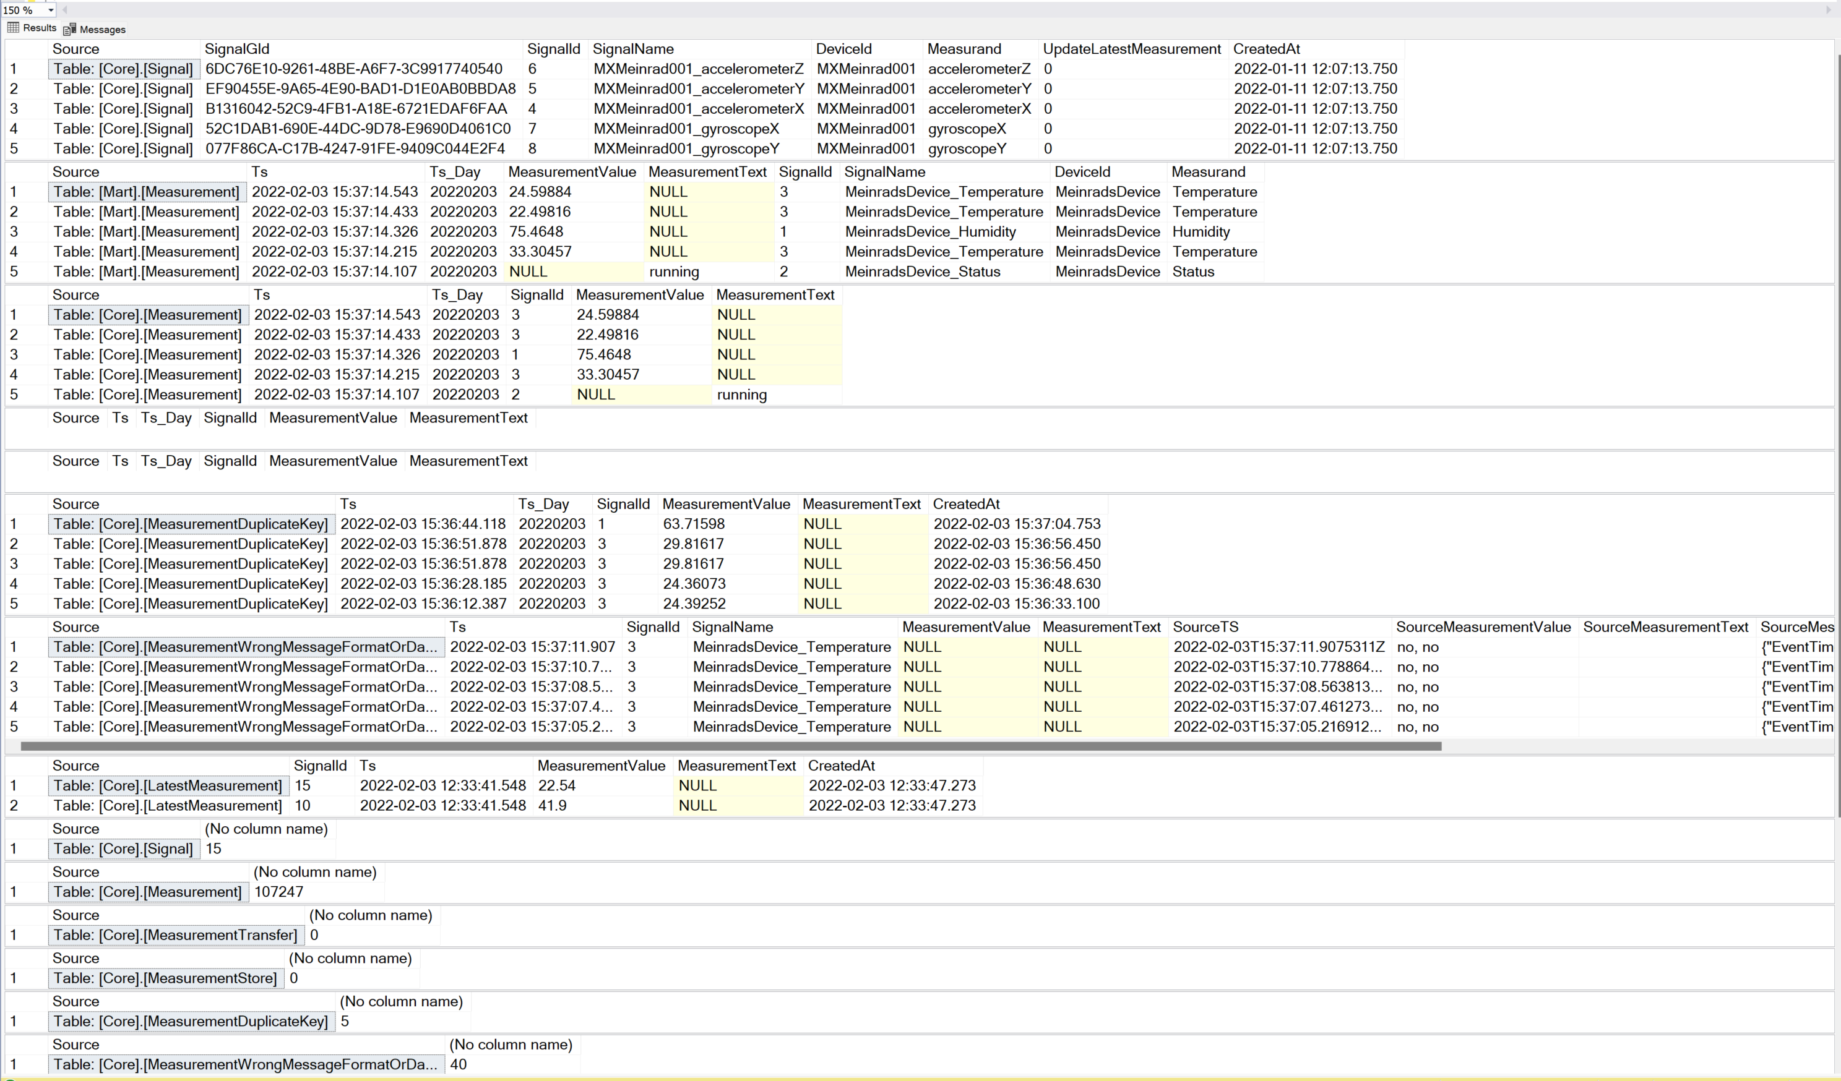
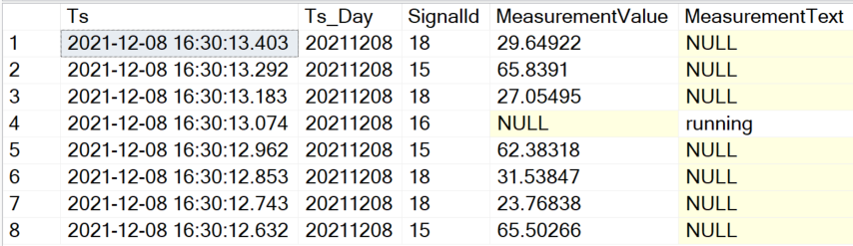
Check Data in Database
SELECT *
FROM [Core].[Signal]
SELECT top 8 *
FROM [Core].[Measurement]
ORDER BY [Ts] DESC
SELECT top 6 *
FROM [Core].[MeasurementWrongMessageFormatOrDataType]
ORDER BY [Ts] DESC
Stored Procedure:[Core].[GetOverviewOfDataInDatabase]

Slide 25
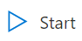
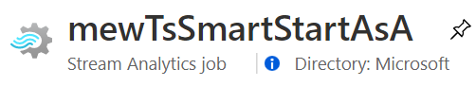
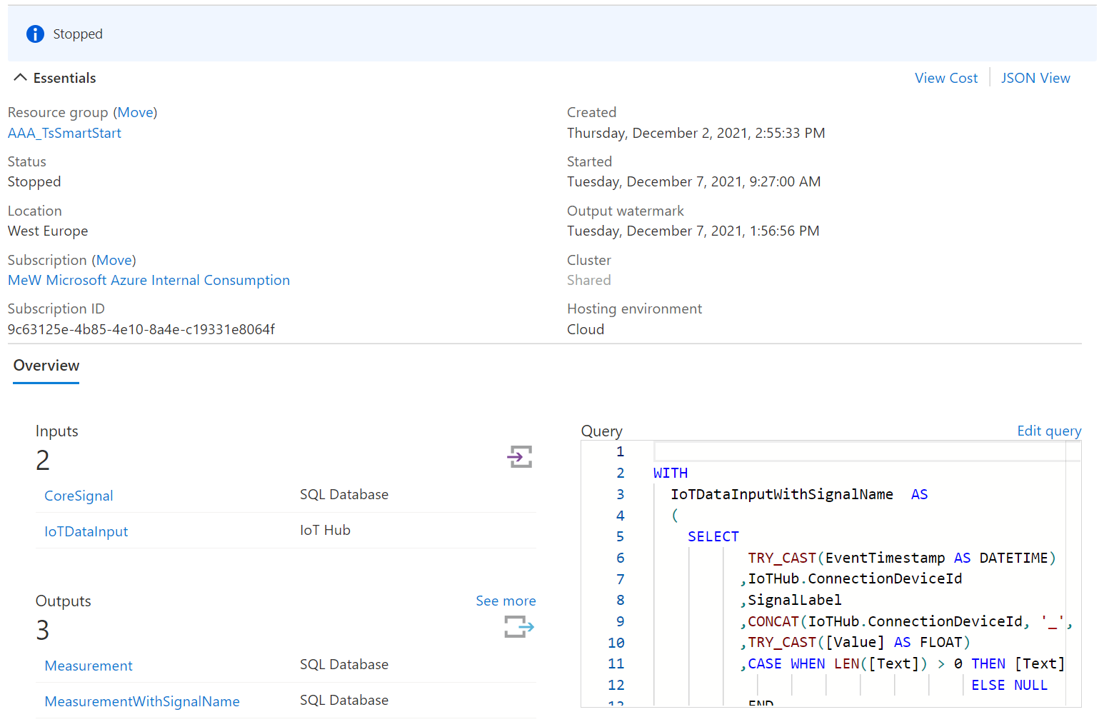
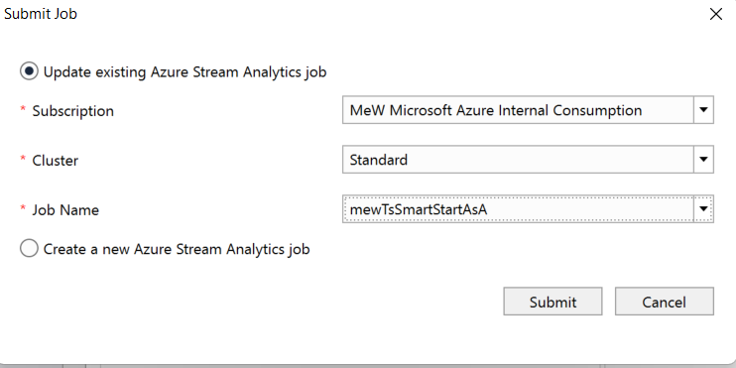
Deploy Stream Analytics Job
3
TsSmartStreamAnalyticsJob
Click

Slide 26
Ready to run
Ingest
Core
Mart
Stream Analytics

Slide 27
Agenda
Goal and Solution Overview
Deploy Solution
Internals
Auto Signal Registration
Handle Duplicate Values
Storage Details
Poor man’s digital twin
Restrict Data Access
Efficient Queries
Monitor activity/reset the database
Database Tiers
Conclusion and next Steps

Slide 28
More Details
Avoid duplicate delivery of events
(Keep them for quality control)
Deal with mal formed events
(Keep them for quality control)
Show data only allowed rows, company internal but also for third party users
IoT Hub
Stream Analytics
Azure SQL Database
Keep history of all security relevant meta data changes
Replace signal name with internal SignalId
Reference
Data

Slide 29
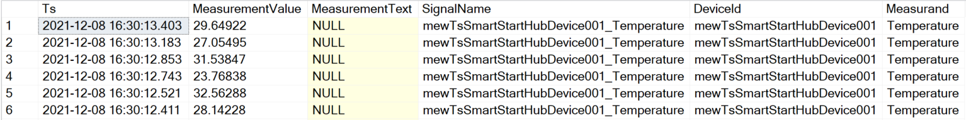
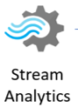
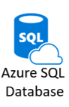

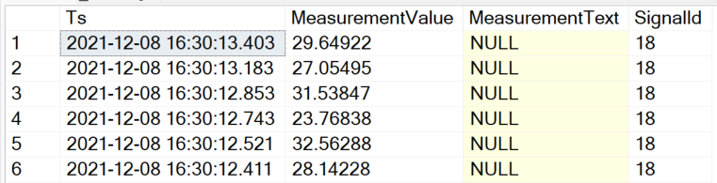
Signal Registration Process
[Ingest].[MeasurementWithSignalName]
{
"EventTimestamp": "2021-12-08T14:01:14.5094082Z",
"SignalLabel": "Temperature",
"Value": "12.34",
"Text": "",
"EventProcessedUtcTime": "2021-12-08T14:01:14.5771421Z",
"PartitionId": 1,
"EventEnqueuedUtcTime": "2021-12-08T14:01:15.0040000Z",
"IoTHub": {
"MessageId": null,
"CorrelationId": null,
"ConnectionDeviceId": "mewTsSmartStartHubDevice001",
"ConnectionDeviceGenerationId": "637740536776612383",
"EnqueuedTime": "2021-12-08T14:01:15.0050000Z"
}
}
[Ingest].[Measurement]

Slide 30
Main Azure SQL Database Structures
Instead of INSERT Trigger
Ingest
Core
Mart
Stream Analytics
Creates missing signals and stores them in [Core].[Signal]
Resolves [SignalId] and routes the event to [Ingest].[Measurement]

Slide 31
Auto Signal Registration
CREATE TRIGGER [Ingest].[IngestMeasurementWithSignalNameInsteadOfInsertTrigger]
ON [Ingest].[MeasurementWithSignalName]
INSTEAD OF INSERT
AS
SET NOCOUNT ON;
-- Insert missing signal name into Signal table
INSERT INTO [Core].[Signal]
([SignalName]
,[DeviceId]
,[Measurand])
SELECT DISTINCT [SignalName], [DeviceId], [Measurand]
FROM INSERTED
WHERE NOT EXISTS (SELECT 'X' FROM [Core].[Signal] AS s WHERE s.[SignalName] = INSERTED.[SignalName]);
-- Copy events to regular Measurement ingest facade
INSERT INTO [Ingest].[Measurement]
([Ts]
,[SignalId]
,[MeasurementValue]
,[MeasurementText])
SELECT [Ts]
,[SignalId]
,[MeasurementValue]
,[MeasurementText]
FROM INSERTED AS i
INNER JOIN [Core].[Signal] AS s
ON i.[SignalName] = s.[SignalName];
GO

Slide 32
Handle Duplicate Values
Event Delivery Guarantees (Azure Stream Analytics)
Exactly-once processing
Azure Stream Analytics guarantees exactly once processing.
Exactly-once delivery
Azure Stream Analytics guarantes at-least-once delivery to output sinks, which guarantees that all results are outputted, but duplicate results may occur. However exactly-once delivery may be achieved with several outputs such as Cosmos DB or SQL
The Azure instance is upgraded while the job is running
The Stream Analytics job is upgraded or an issue occurs with connectivity or reliability to the job output
The Azure instance running the job has an outage
Stream Analytics job is started with the when last stopped option

Slide 33
Handle Duplicate Values - 2
Cosmos DB
Using Cosmos DB, Azure Stream Analytics guarantees exactly-once delivery. Since Azure Stream Analytics uses upsert, no action is needed by the user. See more information on Azure Stream Analytics output to CosmosDB.
SQL
When using SQL output, users can achieve exactly-once delivery if the following requirements are met:
all output streaming events have a natural key, i.e. are uniquely identifiable either by a field or a combination of fields.
the output SQL table has a unique constraint (or primary key) created using the natural key of the output events.
This is sufficient to avoid duplicates because the SQL output honors any constraints placed on the table by skipping any events that cause a unique constraint violation.
Avoid duplicate delivery of events
(Keep them for quality control)
Just skipping means the fact that duplicates occurred disappears

Slide 34
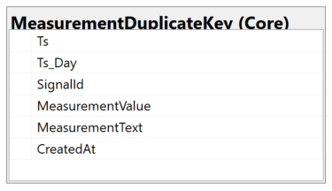
Handle Duplicate Values - 4
Instead of INSERT Trigger
Ingest
Core
Stream Analytics
Detect duplicate events and stores them in exception table [Core].[MeasurementDuplicateKey]
Calculates Partition Key Attribute and stores new events in [Core].[Measurement]

Slide 35
Handle Duplicate Values - 5
CREATE TRIGGER [Ingest].[IngestMeasurementInsteadOfInsertTrigger]
ON [Ingest].[Measurement]
INSTEAD OF INSERT
AS
SET NOCOUNT ON;
-- This is new
-- Store measurements that already exist in the duplicate key table.
INSERT INTO [Core].[MeasurementDuplicateKey]
( [Ts]
,[Ts_Day]
,[SignalId]
,[MeasurementValue]
,[MeasurementText]
,[CreatedAt])
SELECT
i.[Ts]
,CONVERT(INT, CONVERT(VARCHAR, i.[Ts], 112)) as Ts_Day -- Calculate partition Key
,CONVERT(INT, i.[SignalId])
,i.[MeasurementValue]
,i.[MeasurementText]
,GETDATE()
FROM INSERTED as i
INNER JOIN [Core].[AllMeasurement] as m
ON i.[SignalId] = m.[SignalId]
AND i.[Ts] = m.[Ts]
AND m.[Ts_Day] = CONVERT(DATETIME, CONVERT(DATE, i.[Ts]))-- Enable partition elimination
...

Slide 36
Handle Duplicate Values – 5a
2nd part of TRIGGER [Ingest].[IngestMeasurementInsteadOfInsertTrigger]
...
-- Insert duplicate records if the happen in one batch of data
INSERT INTO [Core].[MeasurementDuplicateKey]
( [Ts]
,[Ts_Day]
,[SignalId]
,[MeasurementValue]
,[MeasurementText]
,[CreatedAt])
SELECT [INSERTED].[Ts]
,CONVERT(DATE, [INSERTED].[Ts]) AS [Ts_Day] -- Calculate partition Key
,CONVERT(INT, [INSERTED].[SignalId]) AS [SignalId]
,[MeasurementValue]
,[MeasurementText]
,GETDATE()
FROM [INSERTED]
INNER JOIN (SELECT i.[Ts]
,i.[SignalId]
,COUNT(*) as c
FROM INSERTED as i
GROUP BY i.[Ts]
,i.[SignalId]
HAVING COUNT(*) > 1
) AS DUPLICATE_ROWS
ON [INSERTED].[Ts] = [DUPLICATE_ROWS].[Ts]
AND [INSERTED].[SignalId] = [DUPLICATE_ROWS].[SignalId]

Slide 37
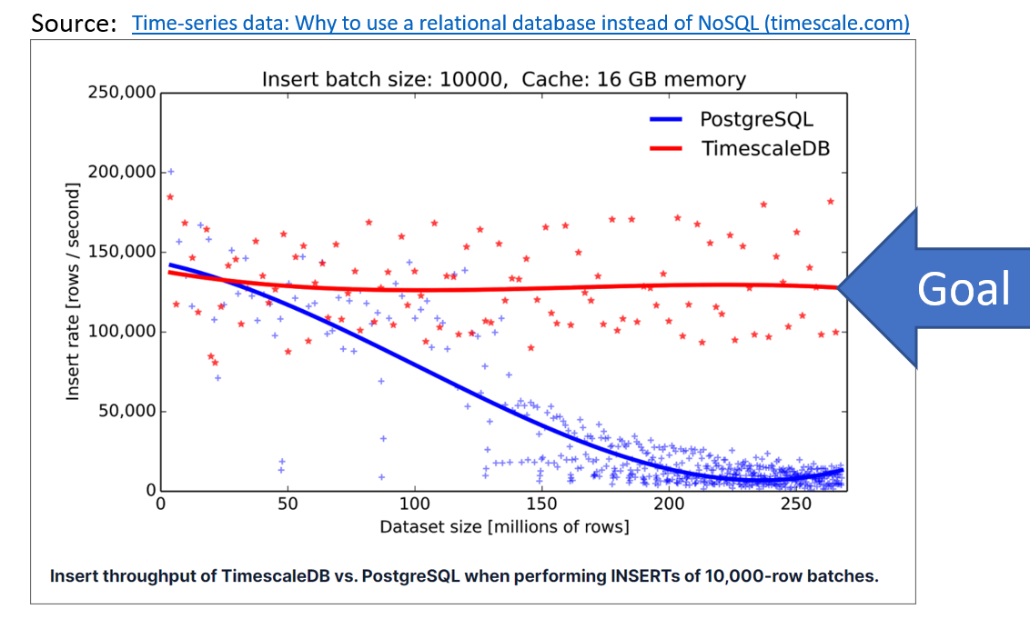
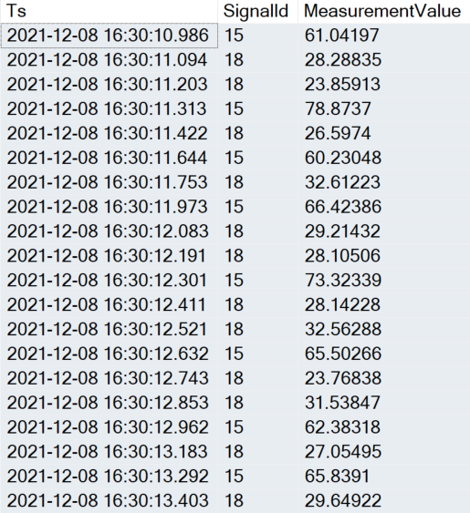
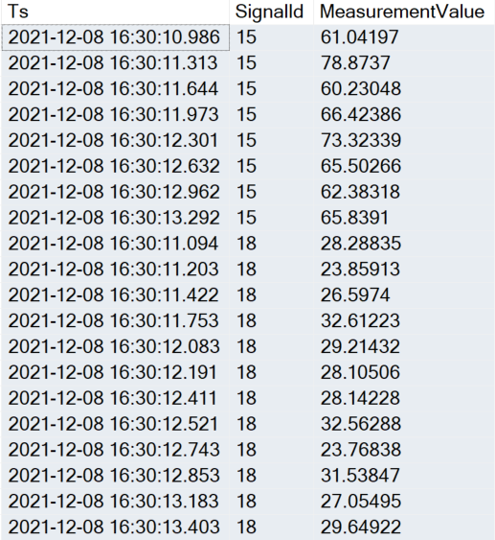
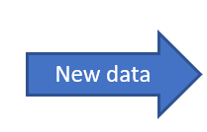
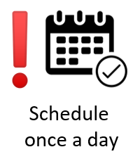
Storage Details – Basic Usage
IoT data arrives in batches
“ordered by” Ts
The typical query for Time Series data is:
select [Ts], [SignalId], [MeasurementValue]
from [Core].[Measurement]
where [SignalId] = 15
AND [Ts] between '2021-12-08 16:30:05' and '2021-12-08 16:30:10.876'
order by SignalId, TS
The index will be extremely fragmented
after a few inserts
ALTER TABLE [Core].[Measurement]
ADD CONSTRAINT [PK_Core_Measurement] PRIMARY KEY CLUSTERED
([SignalId] ASC,
[Ts] DESC,
[Ts_Day] DESC
)
[Core].[Measurement]
[Core].[Measurement]
Today -2
Today -2
Today -1
Today -1
New data
Today
New data
Today
EXEC [Core].[RebuildFragmentedIndexes]
Fragmented
Not fragmented

Slide 38

Storage Details – Basic Usage -2
Day Partition objects
CREATE TABLE [Core].[Measurement] (
[Ts] DATETIME2 (3) NOT NULL,
[Ts_Day] DATETIME NOT NULL,
[SignalId] INT NOT NULL,
[MeasurementValue] REAL NULL,
[MeasurementText] NVARCHAR (4000) NULL,
[MeasurementContext] NVARCHAR (4000) NULL,
[CreatedAt] DATETIME2 (3) NULL,
CONSTRAINT [PK_Core_Measurement] PRIMARY KEY CLUSTERED ([SignalId] ASC, [Ts] DESC, [Ts_Day] DESC) WITH (DATA_COMPRESSION = PAGE) ON [dayPartitionScheme] ([Ts_Day]),
CONSTRAINT [FK_Core_Measurement_Signal] FOREIGN KEY ([SignalId]) REFERENCES [Core].[Signal] ([SignalId])
) ON [dayPartitionScheme] ([Ts_Day]);
CREATE PARTITION SCHEME [dayPartitionScheme] AS PARTITION [dayPartitionFunction]
TO ([PRIMARY], [PRIMARY]);
Partition 1: > 1900-01-01 00:00:00
Partition 2: >= 1900-01-01 00:00:00
1900-01-01 00:00:00
EXECUTE [Partition].[MaintainPartitionBorders]
CREATE PARTITION FUNCTION [dayPartitionFunction](DATETIME)
AS RANGE RIGHT FOR VALUES ('1900-01-01');
Creates new partitions for the upcoming days (~ + 40 days in future)

Slide 39
Storage Details – Advanced Usage
For large data history, day partitioning leads to too many partitions
There is a mixed model with day and month partitions
[Core].[OptimiseDataStorage]
Table: [Core].[MeasurementStore]
(Month partition)
View:
[Core].[AllMeasurement]
Table:
[Core].[Measurement]
(Day partition)
A 45.0
B 12.1
C 77.4
A 47.0
B 22.1
C 55.1
A 45.5
B 15.5
D 11.4
A 55.1
B 22.1
C 78.5
A 45.4
B 42.1
D 15.4
A 45.1
B 12.5
C 77.8
A 35.0
B 15.1
C 75.5
A 45.3
B 18.9
C 67.4
20210128
20210129
20210130
20210131
20210202
20210203
20210204
…
20210201
20210301

Slide 40
Storage Details – Advanced Usage
For large data history, day partitioning leads to too many partitions
There is a mixed model with day and month partitions
[Core].[OptimiseDataStorage]
A 45.0
B 12.1
C 77.4
A 47.0
B 22.1
C 55.1
A 45.5
B 15.5
D 11.4
A 45.4
B 42.1
D 15.4
Table: [Core].[MeasurementStore]
(Month partition)
A 55.1
B 22.1
C 78.5
Table: [Core].[MeasurementTransfer]
(Month partition)
[Core].[OptimiseDataStorage]
View:
[Core].[AllMeasurement]
Step 1: Partition Switch
Table:
[Core].[Measurement]
(Day partition)
A 45.1
B 12.5
C 77.8
A 35.0
B 15.1
C 75.5
A 45.3
B 18.9
C 67.4
20210128
20210129
20210130
20210131
20210202
20210203
20210204
…
20210201
20210301

Slide 41
Storage Details – Advanced Usage
For large data history, day partitioning leads to too many partitions
There is a mixed model with day and month partitions
[Core].[OptimiseDataStorage]
A 45.0
B 12.1
C 77.4
A 47.0
B 22.1
C 55.1
A 45.5
B 15.5
D 11.4
A 45.4
B 42.1
D 15.4
Table: [Core].[MeasurementStore]
(Month partition)
A 55.1
B 22.1
C 78.5
Table: [Core].[MeasurementTransfer]
(Month partition)
A 45.1
B 12.5
C 77.8
[Core].[OptimiseDataStorage]
View:
[Core].[AllMeasurement]
Step 1: Partition Switch
Table:
[Core].[Measurement]
(Day partition)
C 69.0
A 29.0
A 35.0
B 15.1
C 75.5
A 45.3
B 18.9
C 67.4
20210128
20210129
20210130
20210131
20210202
20210203
20210204
…
20210201
20210301

Slide 42
Storage Details – Advanced Usage
For large data history, day partitioning leads to too many partitions
There is a mixed model with day and month partitions
[Core].[OptimiseDataStorage]
A 45.0
B 12.1
C 77.4
A 47.0
B 22.1
C 55.1
A 45.5
B 15.5
D 11.4
A 45.4
B 42.1
D 15.4
Table: [Core].[MeasurementStore]
(Month partition)
A 55.1
B 22.1
C 78.5
Step 2: Copy rows
Table: [Core].[MeasurementTransfer]
(Month partition)
A 45.1
B 12.5
C 77.8
[Core].[OptimiseDataStorage]
View:
[Core].[AllMeasurement]
Step 1: Partition Switch
Table:
[Core].[Measurement]
(Day partition)
C 69.0
A 29.0
A 35.0
B 15.1
C 75.5
A 45.3
B 18.9
C 67.4
20210128
20210129
20210130
20210131
20210202
20210203
20210204
…
20210201
20210301
EXEC [Core].[CopyMeasurementFromTs_DayToTs_Day] @FromTs_Day = 20211211, @MoveDaysBack = 14, @OffsetMillisecond = 1
Helpful SP to generate test data
Notes:
EXEC [Core].[OptimiseDataStorage]
EXEC [Core].[CopyMeasurementFromTs_DayToTs_Day] @FromTs_Day = 20211211, @MoveDaysBack = 14, @OffsetMillisecond = 1

Slide 43
Storage Details – Advanced Usage -2
CREATE TABLE [Core].[MeasurementStore] (
[Ts] DATETIME2 (3) NOT NULL,
[Ts_Day] DATETIME NOT NULL,
[SignalId] INT NOT NULL,
[MeasurementValue] REAL NULL,
[MeasurementText] NVARCHAR (4000) NULL,
[MeasurementContext] NVARCHAR (4000) NULL,
[CreatedAt] DATETIME2 (3) NULL
) ON [monthPartitionScheme] ([Ts_Day]);
CREATE NONCLUSTERED INDEX [NCIX_CoreMeasurementStoreTsTs_DaySignalId]
ON [Core].[MeasurementStore]([Ts] ASC, [Ts_Day] ASC, [SignalId] ASC) WITH (DATA_COMPRESSION = PAGE)
ON [monthPartitionScheme] ([Ts_Day]);
CREATE CLUSTERED COLUMNSTORE INDEX [CCI_Core_MeasurementStore]
ON [Core].[MeasurementStore]
ON [monthPartitionScheme] ([Ts_Day]);
Notes:
Check if attribute order in non clustered index makes sense

Slide 44



Quick Overview of data in the database
EXEC [Core].[GetOverviewOfDataInDatabase]

Slide 45




Remove Data from Measurement<XXX> table
EXECUTE [Partition].[RemoveDataPartitionsFromTable]
@SchemaName = 'Core'
,@TableName = 'MeasurementStore'
,@TS_Day_LowWaterMark = '2021-12-01'
,@TS_Day_HighWaterMark = '2021-12-31'
,@PreserveSwitchOutTable = 1
Table: [Core].[MeasurementStore]
(Month partition)
A 45.0
B 12.1
C 77.4
A 47.0
B 22.1
C 55.1
A 45.5
B 15.5
D 11.4
A 55.1
B 22.1
C 78.5
View:
[Core].[AllMeasurement]
Table:
[Core].[Measurement]
(Day partition)
A 45.4
B 42.1
D 15.4
A 45.1
B 12.5
C 77.8
A 35.0
B 15.1
C 75.5
A 45.3
B 18.9
C 67.4
20211228
20211229
20211230
20211231
20220102
20220103
20220104
…
20220101
20220201
[Core].[SwitchedOut_MeasurementStore_20211201_2021-12-14T18:53:05.363]

Slide 46


Remove Data from Measurement<XXX> table -2
EXECUTE [Partition].[RemoveDataPartitionsFromTable]
@SchemaName = 'Core'
,@TableName = 'Measurement'
,@TS_Day_LowWaterMark = '2021-12-14'
,@TS_Day_HighWaterMark = '2021-12-14'
,@PreserveSwitchOutTable = 1
GO

Slide 47
Agenda
Goal and Solution Overview
Deploy Solution
Internals
Auto Signal Registration
Handle Duplicate Values
Storage Details
Poor man’s digital twin
Restrict Data Access
Efficient Queries
Monitor activity/reset the database
Database Tiers
Conclusion and next Steps

Slide 48

Poor man’s digital twin
The question “What is the last know value of a given Signal” can not use “Partition Elimination”
The Table [Core].[LatestMeasurement] contains the latest know value
If [UpdateLatestMeasurement] is set to «true» in [Core].[Signal]
Keeping the table up to date adds some overhead to the system -> update can be enabled if required
Also, helpful to see end-to-end latency of the whole chain

Slide 49
Agenda
Goal and Solution Overview
Deploy Solution
Internals
Auto Signal Registration
Handle Duplicate Values
Storage Details
Poor man’s digital twin
Restrict Data Access
Efficient Queries
Monitor activity/reset the database
Database Tiers
Conclusion and next Steps

Slide 50
Data ingest and presentation
Avoid duplicate delivery of events
(Keep them for quality control)
Deal with mal formed events
(Keep them for quality control)
Show data only allowed rows, company internal but also for third party users
IoT Hub
Stream Analytics
Azure SQL Database
Keep history of all security relevant meta data changes
Replace signal name with internal SignalId
Reference
Data

Slide 51
Azure SQL Database
Ingest
Core
Mart
Stream Analytics
Row level security

Slide 52
Row level security
CREATE FUNCTION [Security].[fn_datapointsecuritypredicate]
(@DataPointId AS int)
RETURNS TABLE
WITH SCHEMABINDING
AS
RETURN SELECT 1 AS fn_datapointsecuritypredicate_result
WHERE (@DataPointId
IN (
-- REGULAR USER
SELECT DISTINCT [DataPointId]
FROM [Security].[ApplicationRoleDataPointAccess]
INNER JOIN [Security].[ApplicationRoleMember]
ON [ApplicationRoleDataPointAccess].[RoleId] = [ApplicationRoleMember].[RoleId]
WHERE [ApplicationRoleMember].[UserId] = SYSTEM_USER
)
)
OR
( -- ADMIN USER EXISTS (SELECT 'x' FROM [Security].[ApplicationRoleMember]
WHERE [RoleId] = 'ApplicationAdmin'
AND [UserId] = SYSTEM_USER)
)
CREATE SECURITY POLICY [dbo].[DataPointFilter]
ADD FILTER PREDICATE [Security].[fn_datapointsecuritypredicate]([SignalId])
ON [Core].[Signal]
WITH (STATE = ON, SCHEMABINDING = ON)

Slide 53

Security related tables

Slide 54
Performance Optimization(Unique Key reference)
CREATE TABLE [Security].[ApplicationUser]
(
[ApplicationUserGId] UNIQUEIDENTIFIER NOT NULL DEFAULT NEWID(),
[UserId] [sysname] NOT NULL CONSTRAINT [UK_Security_ApplicationUser_UserId] UNIQUE([UserId]),
[Remark] VARCHAR (255) NULL,
[CreatedBy] [sysname] NOT NULL CONSTRAINT [df_Security_ApplicationUser_createdby] DEFAULT (suser_sname()),
[ValidFrom] DATETIME2 (7) GENERATED ALWAYS AS ROW START
NOT NULL,
[ValidTo] DATETIME2 (7) GENERATED ALWAYS AS ROW END
NOT NULL,
PRIMARY KEY NONCLUSTERED ([ApplicationUserGId] ASC),
PERIOD FOR SYSTEM_TIME ([ValidFrom], [ValidTo])
)
WITH (SYSTEM_VERSIONING = ON (HISTORY_TABLE=[Security].[ApplicationUserHistory], DATA_CONSISTENCY_CHECK=ON));
CREATE TABLE [Security].[ApplicationRoleMember] (
[ApplicationRoleMemberGId] UNIQUEIDENTIFIER NOT NULL DEFAULT NEWID(),
[RoleId] [sysname] NOT NULL,
[UserId] [sysname] NOT NULL,
[Remark] VARCHAR (255) NULL,
[CreatedBy] [sysname] NOT NULL CONSTRAINT [df_rolemember_createdby] DEFAULT (suser_sname()),
[ValidFrom] DATETIME2 (7) GENERATED ALWAYS AS ROW START NOT NULL,
[ValidTo] DATETIME2 (7) GENERATED ALWAYS AS ROW END NOT NULL,
CONSTRAINT [PK_security_applicationrolemember] PRIMARY KEY NONCLUSTERED ([ApplicationRoleMemberGId] ASC),
CONSTRAINT [UK_security_applicationrolemember] UNIQUE CLUSTERED ([UserId] ASC, [RoleId] ASC),
CONSTRAINT [FK_ApplicationRoleMember_ApplicationRole] FOREIGN KEY ([RoleId]) REFERENCES [Security].[ApplicationRole] ([RoleId]),
CONSTRAINT [FK_ApplicationRoleMember_ApplicationUser] FOREIGN KEY ([UserId]) REFERENCES [Security].[ApplicationUser] ([UserId]),
PERIOD FOR SYSTEM_TIME ([ValidFrom], [ValidTo])
)
WITH (SYSTEM_VERSIONING = ON (HISTORY_TABLE=[Security].[ApplicationRoleMemberHistory], DATA_CONSISTENCY_CHECK=ON));

Slide 55

Temporal Table for Security related tables
CREATE TABLE [Security].[ApplicationUser]
(
[ApplicationUserGId] UNIQUEIDENTIFIER NOT NULL DEFAULT NEWID(),
[UserId] [sysname] NOT NULL CONSTRAINT [UK_Security_ApplicationUser_UserId] UNIQUE([UserId]),
[Remark] VARCHAR (255) NULL,
[CreatedBy] [sysname] NOT NULL CONSTRAINT [df_Security_ApplicationUser_createdby] DEFAULT (suser_sname()),
[ValidFrom] DATETIME2 (7) GENERATED ALWAYS AS ROW START
NOT NULL,
[ValidTo] DATETIME2 (7) GENERATED ALWAYS AS ROW END
NOT NULL,
PRIMARY KEY NONCLUSTERED ([ApplicationUserGId] ASC),
PERIOD FOR SYSTEM_TIME ([ValidFrom], [ValidTo])
)
WITH (SYSTEM_VERSIONING = ON (HISTORY_TABLE=[Security].[ApplicationUserHistory], DATA_CONSISTENCY_CHECK=ON));

Slide 56
Agenda
Goal and Solution Overview
Deploy Solution
Internals
Auto Signal Registration
Handle Duplicate Values
Storage Details
Poor man’s digital twin
Restrict Data Access
Efficient Queries
Monitor activity/reset the database
Database Tiers
Conclusion and next Steps

Slide 57
Effizient Queries
Partition elimination is key
declare @FromTs DATETIME = '2021-12-11 12:37:57.119'
,@ToTs DATETIME = '2021-12-11 13:37:57.119'
,@SignalId INT = 1
SELECT *
FROM [Core].[AllMeasurement]
WHERE [SignalId] = @SignalId
AND [Ts_Day] >= CONVERT(DATETIME, CONVERT(DATE, @FromTs))
AND [Ts_Day] <= CONVERT(DATETIME, CONVERT(DATE, @FromTs))
AND [Ts] >= @FromTs
AND [Ts] <= @ToTs
SELECT *
FROM [Mart].[GetMeasurementForSignal] (1 ,'2021-12-11 12:37:57.119' ,'2021-12-11 13:37:57.119')
Table: [Core].[MeasurementStore]
(Month partition)
A 45.0
B 12.1
C 77.4
A 47.0
B 22.1
C 55.1
A 45.5
B 15.5
D 11.4
View:
[Core].[AllMeasurement]
Table:
[Core].[Measurement]
(Day partition)
A 55.1
B 22.1
C 78.5
A 45.4
B 42.1
D 15.4
A 45.1
B 12.5
C 77.8
A 35.0
B 15.1
C 75.5
A 45.3
B 18.9
C 67.4
20210128
20210129
20210130
20210131
20210202
20210203
20210204
…
20210201
20210301

Slide 58
Efficient Queries and Power BI – Direct Query
CREATE FUNCTION [Mart].[GetMeasurementForRelativeTimeWindow]
( @DeltaTime VARCHAR(25)
,@EndDateTime DATETIME2(3)
,@DefaultTimeZone VARCHAR(50) = 'Central European Standard Time'
)
RETURNS TABLE
AS
RETURN
With [GetMeasurement]
as
(
SELECT [Ts] AS [Ts_UTC]
,CONVERT(DATETIME2(3),CONVERT(DATETIMEOFFSET, [Ts]) AT TIME ZONE @DefaultTimeZone) AS [Ts]
,[Ts_Day] AS [Ts_Day_PartitionKey_UTC]
,[SignalId]
,[MeasurementValue]
,[MeasurementText]
,CONVERT(DATETIME, CONVERT(DATE, Ts)) AS [Ts_Day_UTC]
-- CONVERT(VARCHAR(12) is required to be able to zoom in PowerBI below seconds
,CONVERT(VARCHAR(12), CONVERT(TIME(3), Ts, 121)) AS [Ts_Time_UTC]
,CONVERT(DATETIME, CONVERT(DATE, CONVERT(DATETIMEOFFSET, [Ts]) AT TIME ZONE @DefaultTimeZone)) AS [Ts_Day]
-- CONVERT(VARCHAR(12) is required to be able to zoom in PowerBI below seconds
,CONVERT(VARCHAR(12), CONVERT(time(3), CONVERT(DATETIMEOFFSET, [Ts]) AT TIME ZONE @DefaultTimeZone)) AS [Ts_Time]
FROM [Core].[AllMeasurement]
CROSS JOIN [Mart].[GetRelativeTimeWindow] (@DeltaTime, @EndDateTime, @DefaultTimeZone)
WHERE [Ts_Day] >= [UtcTs_DayStartDate]
AND [Ts_Day] <= [UtcTs_DayEndDate]
AND [Ts] >= [UtcStartDateTime]
AND [Ts] <= [UtcEndDateTime]
)
select
*
,LEFT([Ts_Time],2) AS [Ts_Hour]
,SUBSTRING([Ts_Time],4,2) AS [Ts_Minute]
,SUBSTRING([Ts_Time],7,2) AS [Ts_Second]
,SUBSTRING([Ts_Time],10,3) AS [Ts_Millisecond]
from [GetMeasurement]
Dynamic M-Parameter

Slide 59



Efficient Queries and Power BI – Direct Query
CREATE FUNCTION [Mart].[GetMeasurementForRelativeTimeWindow]
( @DeltaTime VARCHAR(25)
,@EndDateTime DATETIME2(3) = NULL)
RETURNS TABLE
AS
RETURN
SELECT
[Ts] AS [UctTs]
,CONVERT(DATETIME2(3),CONVERT(DATETIMEOFFSET, [Ts]) AT TIME ZONE 'Central European Standard Time') AS [CetTs]
,[Ts_Day] AS [UctTs_Day]
,[SignalId]
,[MeasurementValue]
,[MeasurementText]
,CONVERT(DATE, Ts) AS [UctTs_Daypart]
-- CONVERT(VARCHAR(12) is required to be able to zoom in PowerBI below seconds
,CONVERT(VARCHAR(12), CONVERT(TIME(3), Ts, 121)) AS [UctTs_Timepart]
,CONVERT(DATE, CONVERT(DATETIMEOFFSET, [Ts]) AT TIME ZONE 'Central European Standard Time') AS [CetTs_Daypart]
-- CONVERT(VARCHAR(12) is required to be able to zoom in PowerBI below seconds
,CONVERT(VARCHAR(12), CONVERT(time(3), CONVERT(DATETIMEOFFSET, [Ts]) AT TIME ZONE 'Central European Standard Time')) AS [CetTs_Timepar]
FROM [Core].[AllMeasurement]
CROSS JOIN [Mart].[GetRelativeTimeWindow] (@DeltaTime, @EndDateTime)
WHERE [Ts_Day] >= [UtcTs_DayStartDate]
AND [Ts_Day] <= [UtcTs_DayEndDate]
AND [Ts] >= [UtcStartDateTime]
AND [Ts] <= [UtcEndDateTime]
Dynamic M-Parameter

Slide 60
Agenda
Goal and Solution Overview
Deploy Solution
Internals
Auto Signal Registration
Handle Duplicate Values
Storage Details
Poor man’s digital twin
Restrict Data Access
Efficient Queries
Monitor activity/reset the database
Database Tiers
Conclusion and next Steps

Slide 61


Monitor Activites
Important operations are logged in the two tables:
[Logging].[TaskLog]
[Logging].[StepLog]
Combined in View [Logging].[LogInfo]
SELECT * FROM [Logging].[TaskLog]
SELECT * FROM [Logging].[StepLog]

Slide 62
Reset the database
Data from the following tables
[Core].[Signal]
[Core].[Measurement]
[Core].[MeasurementTransfer]
[Core].[MeasurementStore]
[Core].[MeasurementDuplicateKey]
[Core].[MeasurementWrongMessageFormatOrDataType]
[Core].[OptimizerInfo]
[Logging].[TaskLog]
[Logging].[StepLog]
can be deleted with the stored procedure
[Partition].[EmptyAllDataTablesYesImConfidentToDo]
The two sequences will also be reset to a start value of 1
[Core].[Id]
[Logging].[LogSequence]
Restart Stream Analytics after a reset, to update cached meta data!

Slide 63
Data ingest and presentation
Instead of Trigger “API – View Layer”
~ 20 lines of T-SQL code
Stream Analytics
~ 20 lines of SQL code
Declarative Row Level Security
~ 20 lines of T-SQL code
Avoid duplicate delivery of events
(Keep them for quality control)
Deal with mal-formed events
(Keep them for quality control)
Show data only allowed rows, company internal but also for third party users
IoT Hub
Stream Analytics
Azure SQL Database
Keep history of all security relevant meta data changes
Replace signal name with internal SignalId
Reference
Data
Temporal Tables
0 lines of T-SQL code
Reference Data in Stream Analytics
~ 5 lines of SQL code

Slide 64
Agenda
Goal and Solution Overview
Deploy Solution
Internals
Auto Signal Registration
Handle Duplicate Values
Storage Details
Poor man’s digital twin
Restrict Data Access
Efficient Queries
Monitor activity/reset the database
Database Tiers
Conclusion and next Steps

Slide 65








Relational
SQL
SQL
MySQL
PostgreSQL
MariaDB
SQL Server in Azure
SQL Server Hyperscale
Azure SQL Data Warehouse
Key-Value, Documents, …
MongoDB API
Table API
Non
Relational
Azure Cosmos DB
Files
Hadoop
Databricks
Azure Data Lake Storage
Some GB to a few TB
Many TB
to some PB

Slide 66




Azure SQL Database Family
Azure SQL DB
Azure SQL Server Hyperscale
Azure Synapse Analytics SQL Pool
DB
[Cache]
Azure SQL Serverless

Slide 67

Scalability
Build your full-PaaS IoT solution with Azure SQL Database - Microsoft Tech Community
Scaling up an IoT workload using an M-series Azure SQL database - Microsoft Tech Community

Slide 68
Current Data Volume (after ~ 6 months up and running)
20’000’000 events per day
Avg 230 events per second
Peak 20’000 events per second
3'881'478'093 events currently stored in database
Multiple ML Jobs running in the background
~ 20 Interactive Users

Slide 69


Slide 70



Slide 71

Current Scale Level

Slide 72


Utilization

Slide 73
Agenda
Goal and Solution Overview
Deploy Solution
Internals
Auto Signal Registration
Handle Duplicate Values
Storage Details
Poor man’s digital twin
Restrict Data Access
Efficient Queries
Monitor activity/reset the database
Database Tiers
Conclusion and next Steps

